Slide 1
Automation with Ansible
Bernard Parinas
parinab@ph.ibm.com

Slide 2
Agenda
What is Ansible
How Ansible Works
Ansible Use Cases
Learning Ansible with Vagrant (Demo)
Configuration Management with Ansible (Demo)
Zero downtime Deployments with Ansible (Demo)
Q&A

Slide 3
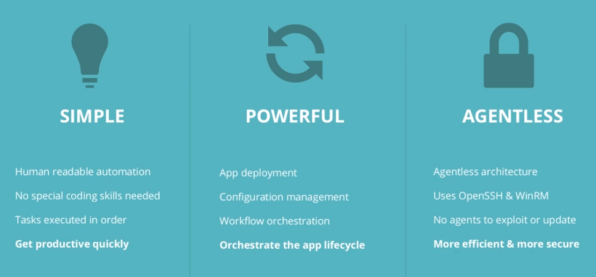
What is Ansible?
source: https://www.ansible.com/resources/videos/quick-start-video

Slide 4
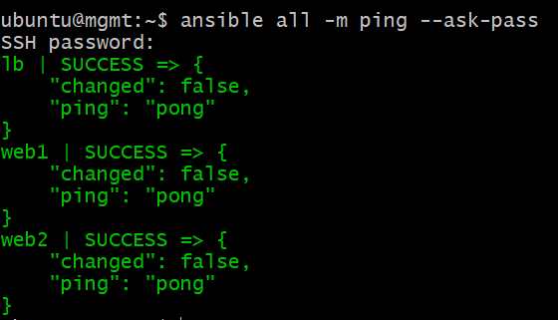

How Ansible Works
LB
Ansible Mgmt Node
VM
WEB1
WEB2
Host Inventory
inventory.ini
Playbook

Slide 5
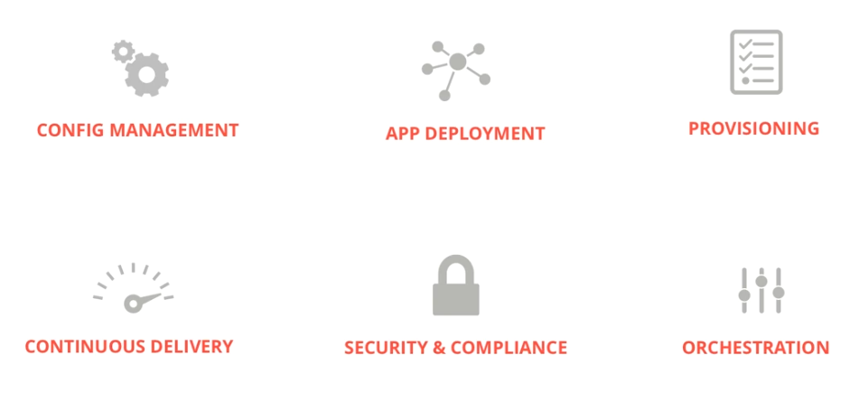
Ansible Use Cases
source: https://www.ansible.com/resources/videos/quick-start-video

Slide 6
Learning Ansible with Vagrant - File Manifest
bootstrap-mgmt.sh – Provision Ansible
bootstrap-lb-web.sh – Deploy Python
Vagrantfile – Defines Vagrant Environment
Vagrantfile:
Vagrant.configure("2") do |config|
#create mgmt node
config.vm.define "mgmt" do |mgmt_config|
mgmt_config.vm.box = "ubuntu/xenial64"
mgmt_config.vm.hostname = "mgmt"
mgmt_config.vm.network "private_network", ip: "192.168.56.5"
mgmt_config.vm.provider "virtualbox" do |vb|
vb.memory = 1024
vb.customize ["modifyvm", :id, "--natdnshostresolver1", "on"]
end
mgmt_config.vm.provision "shell", path: "bootstrap-mgmt.sh"
end

Slide 7
File Manifest (continuation)
#create load balancer
config.vm.define "lb" do |lb_config|
lb_config.vm.box = "ubuntu/xenial64"
lb_config.vm.hostname = "lb"
lb_config.vm.network "private_network", ip: "192.168.56.6“
lb_config.vm.network "forwarded_port", guest_ip: "192.168.56.6", guest: 80, host_ip: "127.0.0.1", host: 8080
lb_config.vm.provider "virtualbox" do |vb|
vb.memory = 1024
vb.customize ["modifyvm", :id, "--natdnshostresolver1", "on"]
end
mgmt_config.vm.provision "shell", path: "bootstrap-lb-web.sh"
end
#create web servers
(1..2).each do |i|
config.vm.define "web#{i}" do |node|
node.vm.box = "ubuntu/xenial64"
node.vm.hostname = "web#{i}"
node.vm.network "private_network", ip: "192.168.56.1#{i}"
node.vm.network "forwarded_port", guest: 80, host: "808#{i}"
node.vm.provider "virtualbox" do |vb|
vb.memory = 1024
vb.customize ["modifyvm", :id, "--natdnshostresolver1", "on"]
end
mgmt_config.vm.provision "shell", path: "bootstrap-lb-web.sh"
end
end
end

Slide 8
File Manifest (continuation)
bootstrap-mgmt.sh:
#configure resolv.conf file
sudo cat >> /etc/resolv.conf <<EOL
nameserver 8.8.8.8
EOL
#install ansible (http://docs.ansible.com/intro_installation.html)
sudo apt-get update
sudo apt-get install software-properties-common
sudo apt-add-repository ppa:ansible/ansible
sudo apt-get update
sudo apt-get --yes install ansible
#configure hosts file for our internal network defined by Vagrantfile
sudo cat >> /etc/hosts <<EOL
#vagrant environment nodes
192.168.56.5 mgmt
192.168.56.6 lb
192.168.56.11 web1
192.168.56.12 web2
EOL

Slide 9
File Manifest (continuation)
bootstrap-lb-web.sh:
#configure resolv.conf file
sudo cat >> /etc/resolv.conf <<EOL
nameserver 8.8.8.8
EOL
#install python
sudo apt-get update
sudo apt-get --yes install python

Slide 10
Test Ansible
ubuntu@mgmt:~$ ansible all -m ping --ask-pass
SSH password:
web1 | SUCCESS => {
"changed": false,
"ping": "pong"
}
lb | SUCCESS => {
"changed": false,
"ping": "pong"
}
web2 | SUCCESS => {
"changed": false,
"ping": "pong"
}
Note: SSH Password can be found here: ~/.vagrant.d/boxes/ubuntu-VAGRANTSLASH-xenial64/20170729.0.0/virtualbox/Vagrantfile

Slide 11
Playbook - Basics
Playbooks contain plays
Plays contain tasks
Tasks call modules
Tasks run sequentially
Handlers are triggered by tasks
and are run once, at the end of plays

Slide 12
Playbook - Establish SSH Trust
Add remote hosts key:
ubuntu@mgmt:~$ ssh-keyscan lb web1 web2 >> .ssh/known_hosts
ubuntu@mgmt:~$ cat .ssh/known_hosts
lb ssh-rsa AAAAB3NzaC1yc2EAAAADAQABAAABAQCmyLmduu8JuzfskRpnMSW8K0noTBUHZOtun6fhtQIneij/WVhOdHbRboW0j5NHBorXYShjLHBw9tBvVYWJ5bDGr5HV+mcs1xlYxqRMXI0I53KU8bm/cbm
N0WHxD3E/aYvsQFM7JGgh0kgLz16ohZv+Lo4WqPhFQicdO0oFiog8r0poh3S7vEzTEbdyrLlDSwmP4KZeA1gyrTn71cmtE6gcAMbm8x6FWVDz5LrL/n6e3FvE2UadWl5iKXc3mVYkZtOJrLSZ/D5HW94VDu8D+
/s4teCWRBkogijIf104bQcJyquQyIV+wSvqPD+SDtnICw6XfrQXbwhzIoeXMoxZihMZ
web1 ssh-rsa AAAAB3NzaC1yc2EAAAADAQABAAABAQDJkkOK5qYZ+HaugA8ZJ0InlaQuhcBnLvyXM3nU5sFGxYolP+lq5o3FP13WgdgiyvTTbtbZS3xcfM9940EP+mdGUkgr2X2szBp8dG5uMiKXMEegKxCCQ
rknUpOoWzWq20YIeSwPgBA10UAelSpsa2/MYRuh7Sac9ImIpesWWPTBgyHP8dywBfoWQj4LHBnsct02qshDKn07s4zVLc8c3N+HSsQ+VzVIT/wgCU11a1Ux6b/0BgHoNoZqZm7oRo47kzf865lDCE+ZvZHA6QB
wSBSshHs2sf9gYcru3Am3h3xQdksPR+Wc4oSmHcOGsdq4QPJGJZrq6204//rfSBkME7u1
web2 ssh-rsa AAAAB3NzaC1yc2EAAAADAQABAAABAQC+njtrfs/7JTtQqRBc+DjKgycX3nF9G/IgsqPr2QG2HflSV9iKMu4w9f/OhgoFpxnwex6eyQsRiOX3w0ABHlhQm32ssdbSQhVwnuShoyeMbCsVjNK0D
gwXi6gt7lrFNYG1GnnnO0lQ6CyTMGtJtnb39HgNlW569Wr1ZC6hyTss+ttq8VkE8yAFgbRQ0bVTRNYijYedtB7AlDyEXQpk+88asWlFkXlRynpgzuJeH3rQNo2jPIOa1FvWKi/voVH7jNNyVSXXRVUtZpdtzlo
UxGGeG+1Z5rDCmKoAGqjN0H5JtSeFdaFOGcSVNoSFhuyZRCTmG1ySXe8TaaK/0BlwQF+n

Slide 13
Playbook - Establish SSH Trust
Generate a private key for management host:
ubuntu@mgmt:~$ ssh-keygen -t rsa -b 2048
Generating public/private rsa key pair.
Enter file in which to save the key (/home/ubuntu/.ssh/id_rsa):
Enter passphrase (empty for no passphrase):
Enter same passphrase again:
Your identification has been saved in /home/ubuntu/.ssh/id_rsa.
Your public key has been saved in /home/ubuntu/.ssh/id_rsa.pub.
The key fingerprint is:
SHA256:4ijMch7syqh0b25SQZwOYER5eE5tn4PEyuE8B9hB2JY ubuntu@mgmt
The key's randomart image is:
+---[RSA 2048]----+
|o=Xo* . |
|.= E O |
| X X o . |
| B = + |
| o o S |
| + + . |
|..B.o . |
|+=.+.o |
|=oo =o |
+----[SHA256]-----+

Slide 14
Playbook - Establish SSH Trust
ubuntu@mgmt:~$ cat ssh-addkey-playbook.yml
---
- hosts: all
become: yes
become_method: sudo
gather_facts: no
remote_user: ubuntu
tasks:
- name: install ssh key
authorized_key: user=ubuntu
key="{{ lookup('file', '/home/ubuntu/.ssh/id_rsa.pub') }}"
state=present

Slide 15
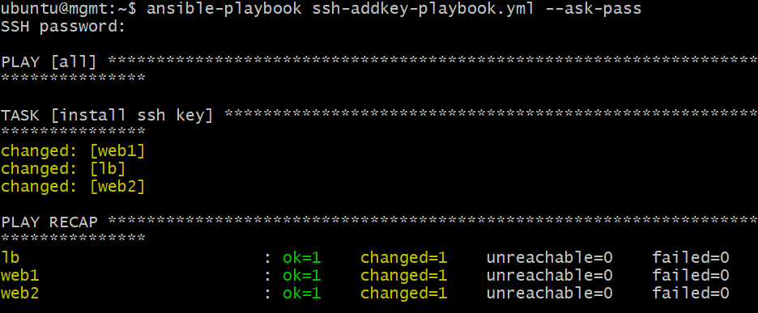
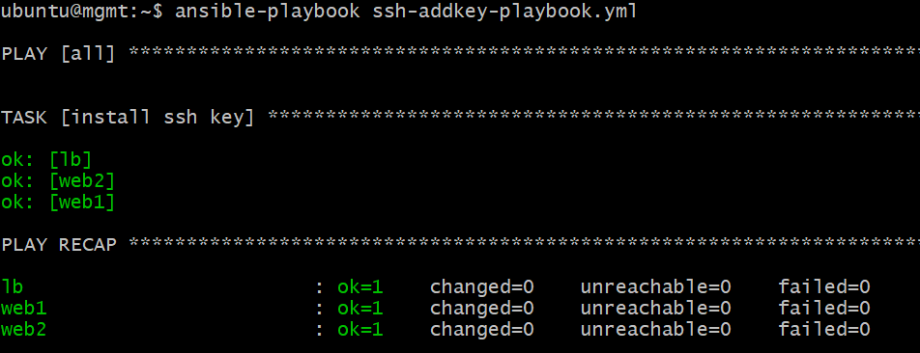
Playbook - Establish SSH Trust
Before
After

Slide 16
Test Ansible (no --ask-pass)
ubuntu@mgmt:~$ ansible all -m ping
web1 | SUCCESS => {
"changed": false,
"ping": "pong"
}
lb | SUCCESS => {
"changed": false,
"ping": "pong"
}
web2 | SUCCESS => {
"changed": false,
"ping": "pong"
}

Slide 17
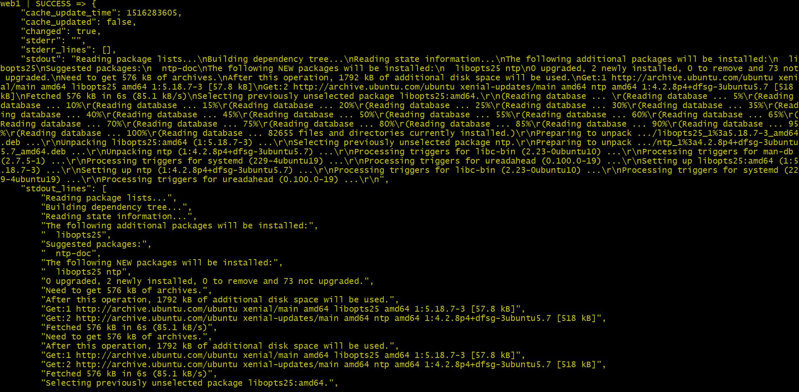

Ansible Ad-hoc Commands
Install ntp package to web1 host:
ubuntu@mgmt:~$ ansible web1 -m apt -a "name=ntp state=installed" –become --user=ubuntu

Slide 18
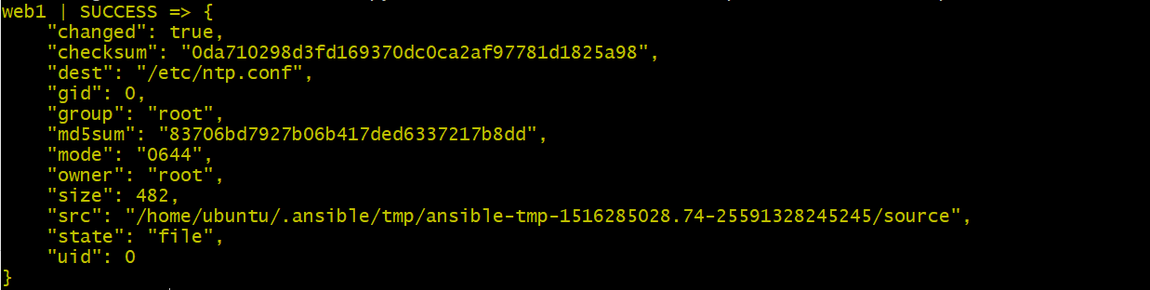
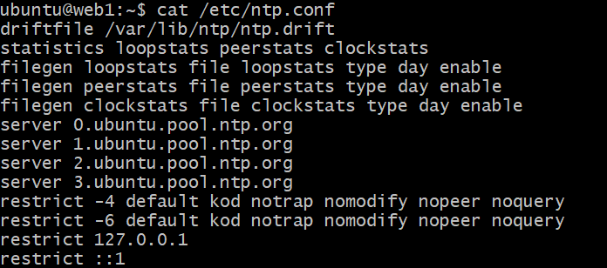
Ansible Ad-hoc Commands
Copy standard ntp.conf file from mgmt to web1 host:
ubuntu@mgmt:~$ ansible web1 -m copy -a "src=/home/ubuntu/files/ntp.conf dest=/etc/ntp.conf mode=644 owner=root group=root" --become --user=ubuntu
Verify ntp.conf content in web1:

Slide 19
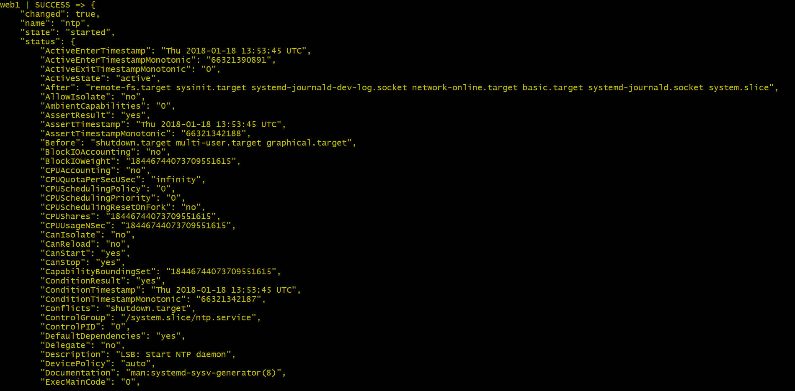

Ansible Ad-hoc Commands
Restart ntp service in web1:
ubuntu@mgmt:~$ ansible web1 -m service -a "name=ntp state=restarted" --become --user=ubuntu

Slide 20
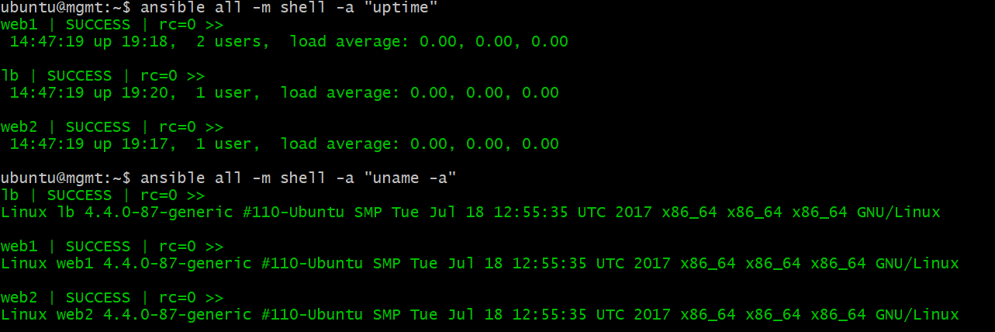
Ansible Ad-hoc Commands
Popular ad-hoc command using shell module:

Slide 21
Playbook – NTP deployment
ubuntu@mgmt:~$ cat ntp-install-playbook.yml
---
- hosts: all
become: yes
become_method: sudo
gather_facts: no
remote_user: ubuntu
tasks:
- name: install ntp
apt: name=ntp state=installed update_cache=yes
- name: write our ntp.conf
copy: src=/home/ubuntu/files/ntp.conf dest=/etc/ntp.conf mode=644 owner=root group=root
notify: restart ntp
- name: start ntp
service: name=ntp state=started
handlers:
- name: restart ntp
service: name=ntp state=restarted

Slide 22
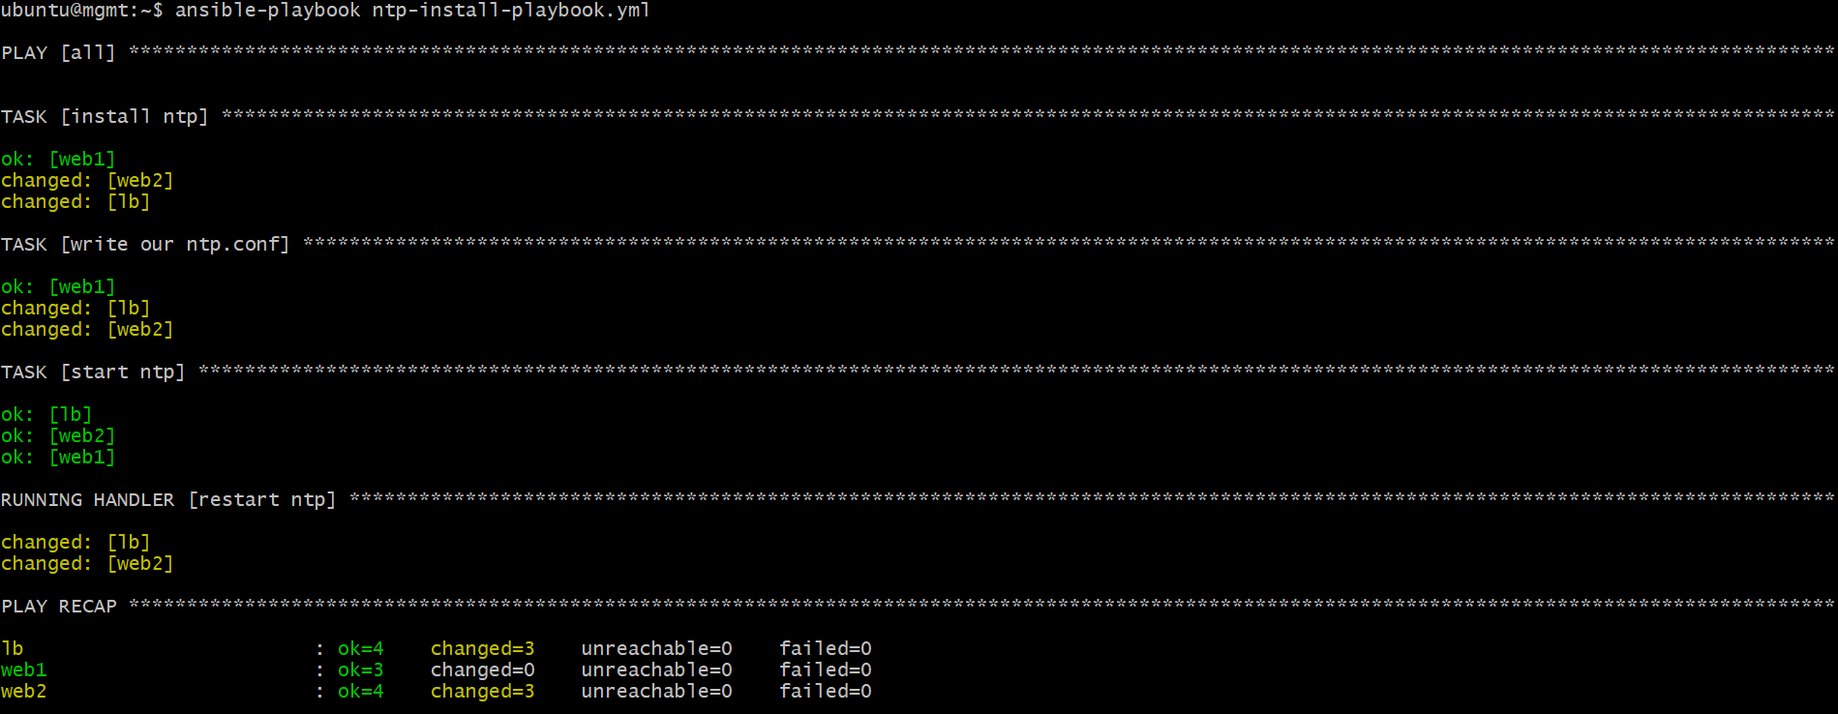
Playbook – NTP deployment

Slide 23
Playbook – NTP deployment (Jinja Template)
ubuntu@mgmt:~$ cat ntp-install-template-playbook.yml
---
- hosts: all
become: yes
become_method: sudo
gather_facts: no
remote_user: ubuntu
vars:
noc_ntpserver: 0.asia.pool.ntp.org
tasks:
- name: install ntp
apt: name=ntp state=installed update_cache=yes
- name: write our ntp.conf
template: src=/home/ubuntu/files/ntp.conf.j2 dest=/etc/ntp.conf mode=644 owner=root group=root
notify: restart ntp
- name: start ntp
service: name=ntp state=started
handlers:
- name: restart ntp
service: name=ntp state=restarted

Slide 24
Playbook – NTP deployment (Jinja Template)
ubuntu@mgmt:~$ cat files/ntp.conf.j2
{{ ansible_managed | comment }}
driftfile /var/lib/ntp/ntp.drift
statistics loopstats peerstats clockstats
filegen loopstats file loopstats type day enable
filegen peerstats file peerstats type day enable
filegen clockstats file clockstats type day enable
server {{ noc_ntpserver }}
restrict -4 default kod notrap nomodify nopeer noquery
restrict -6 default kod notrap nomodify nopeer noquery
restrict 127.0.0.1
restrict ::1

Slide 25
Playbook – NTP deployment (ansible.cfg)
ubuntu@mgmt:~$ cat ansible.cfg
[defaults]
inventory = /home/ubuntu/inventory.ini
ansible_managed = This file is managed by Ansible.%n
template: {file}
date: %Y-%m-%d %H:%M:%S
user: {uid}
host: {host}

Slide 26
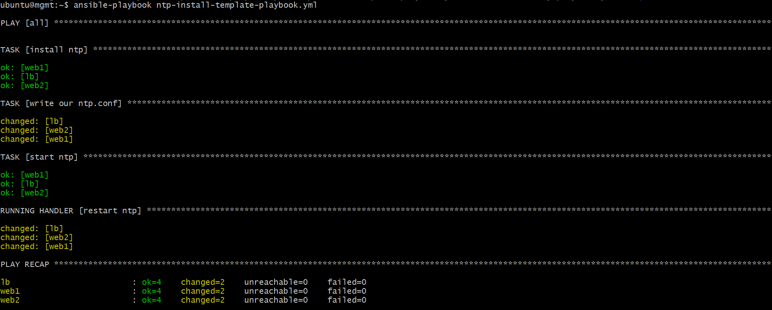
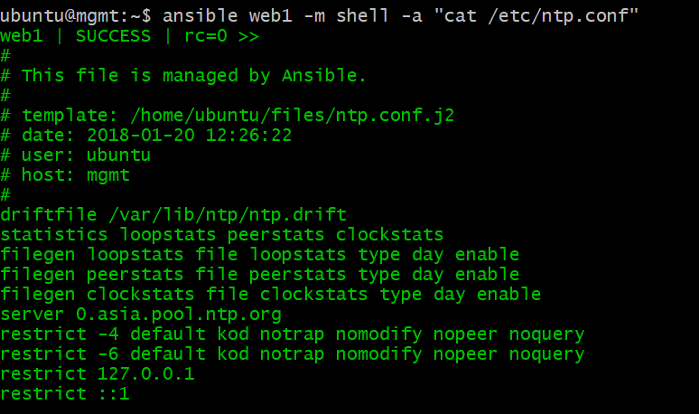
Playbook – NTP deployment (Jinja Template)

Slide 27

Playbook – gather_facts
ubuntu@mgmt:~$ ansible web1 -m setup | less

Slide 28
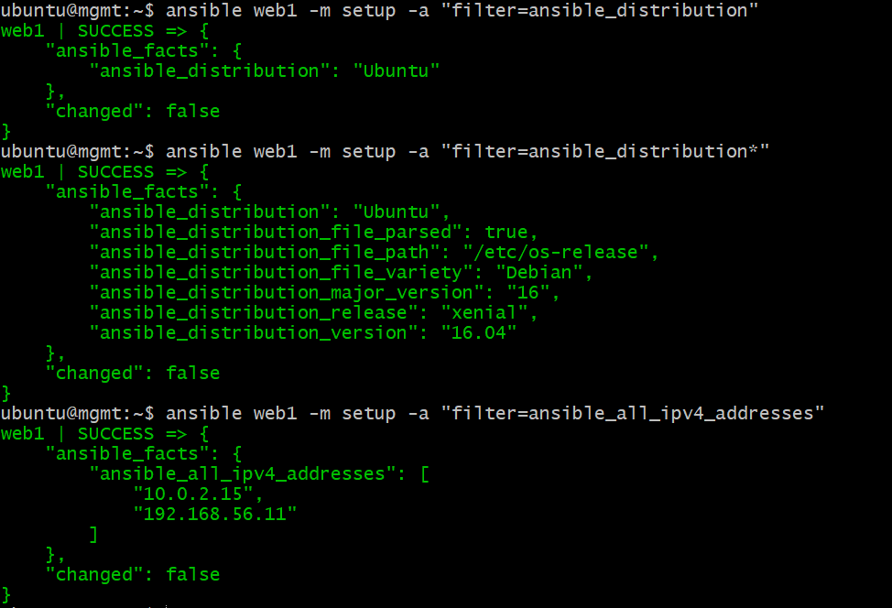
Playbook – gather_facts (filter)

Slide 29
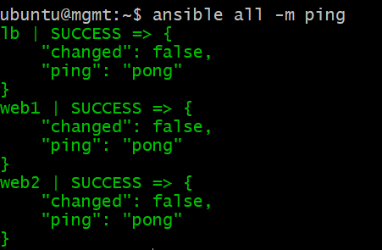
Configuration Management with Vagrant
LB
SSH Trust
Ansible Mgmt Node
VM
WEB1
SSH Trust
SSH Trust
WEB2
Host Inventory
inventory.ini
Playbook
site-deploy-playbook.yml

Slide 30
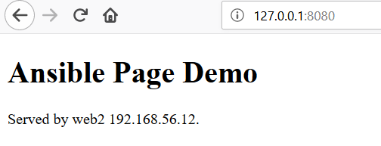

Configuration Management - Use Case
WEB1
LB
Host Machine
http://localhost:8080
WEB2
Notes:
Vagrantfile (load balancer):
lb_config.vm.network "forwarded_port", guest: 80, host: 8080
haproxy.conf:
backend app
bind 192.168.56.6:80
balance roundrobin
server web1 192.168.56.11 check port 80
server web2 192.168.56.12 check port 80

Slide 31
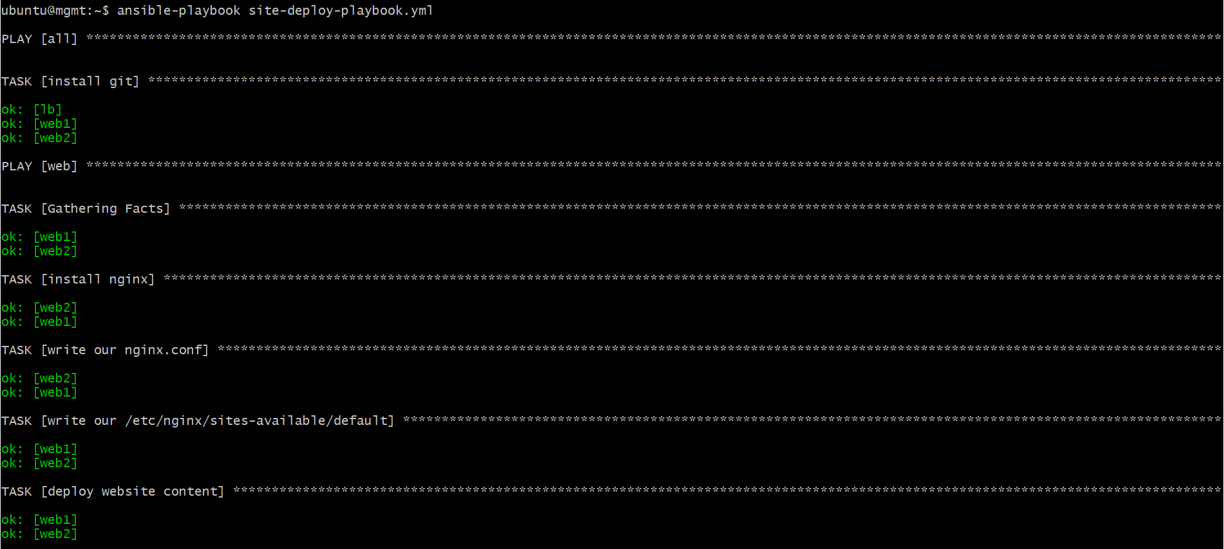
Configuration Management with Vagrant

Slide 32
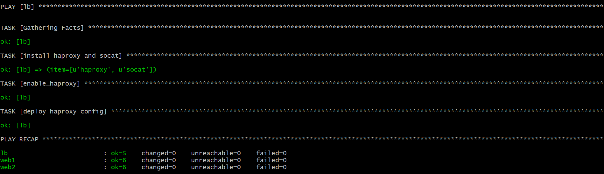
Configuration Management with Vagrant

Slide 33
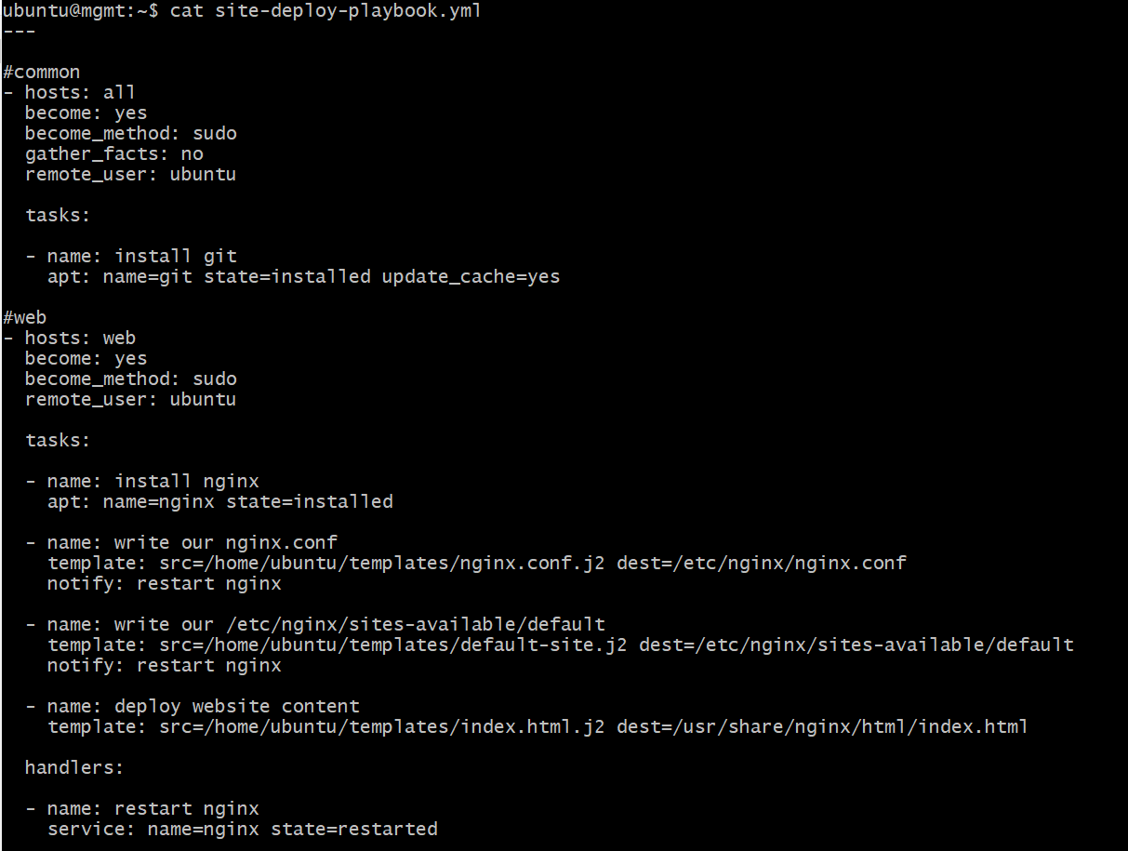
Playbook – Site Deploy (web)

Slide 34
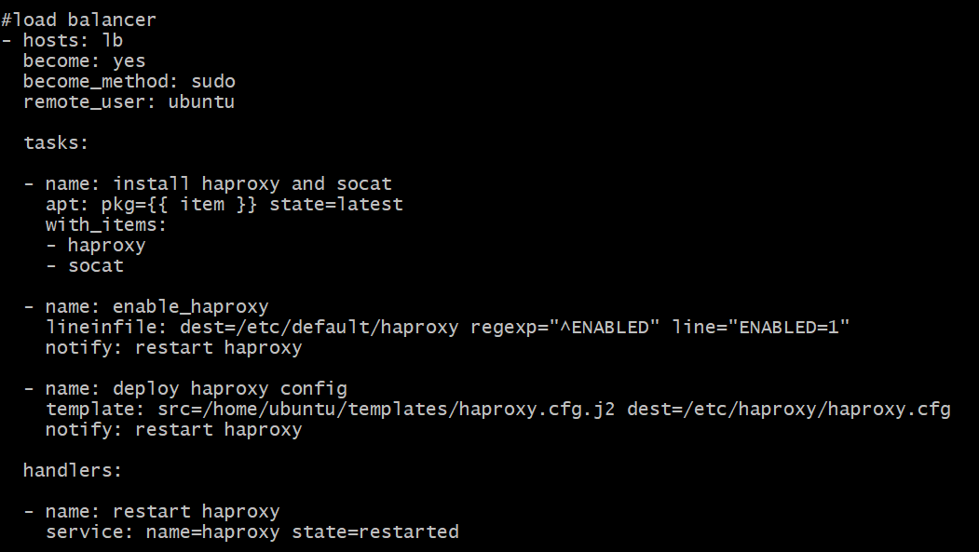
Playbook – Site Deploy (load balancer)

Slide 35
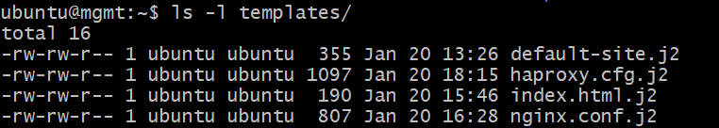
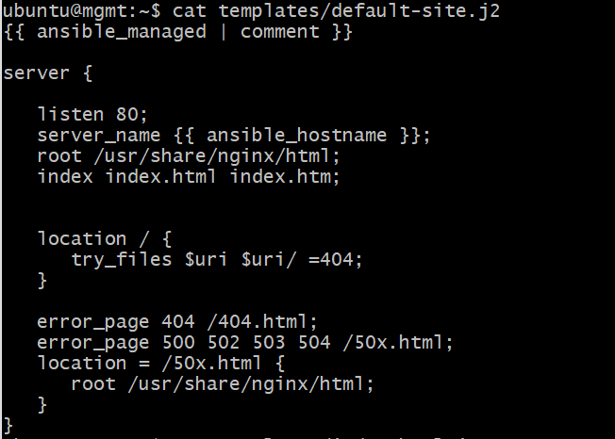
Templates – default-site.j2 (gather_facts on)
Notes:
gather facts on for “ansible_hostname”

Slide 36
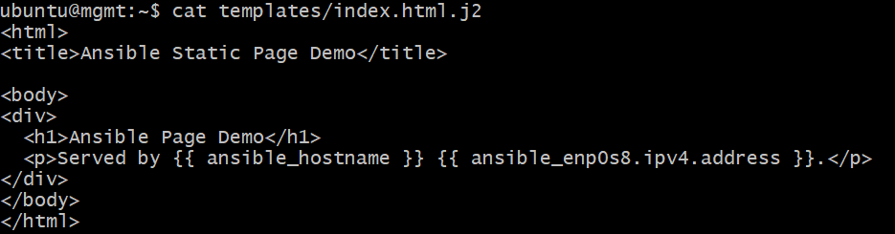
Templates – index.html.j2

Slide 37
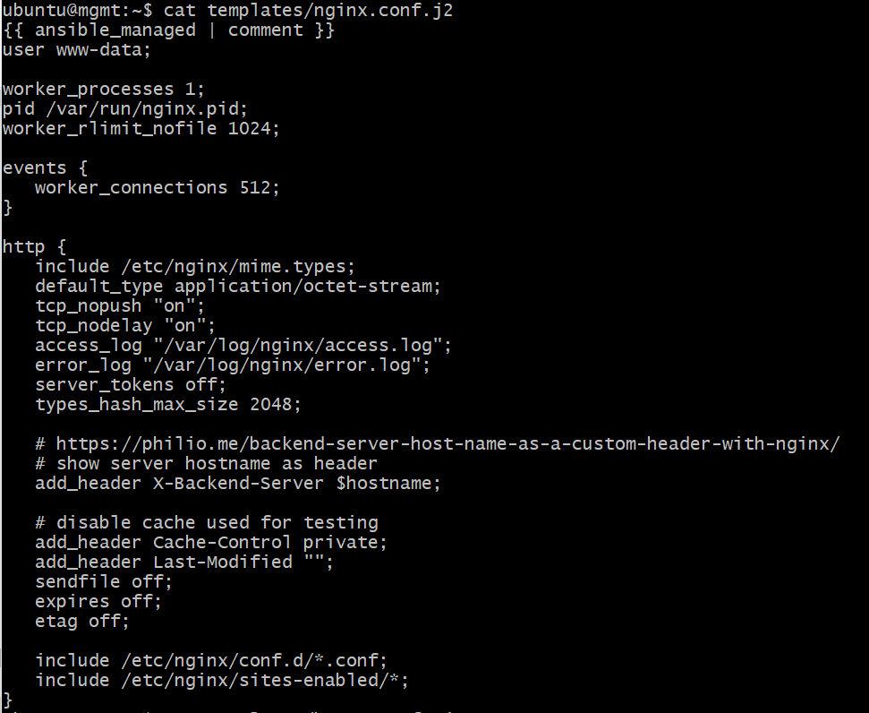
Templates – nginx.conf.j2

Slide 38
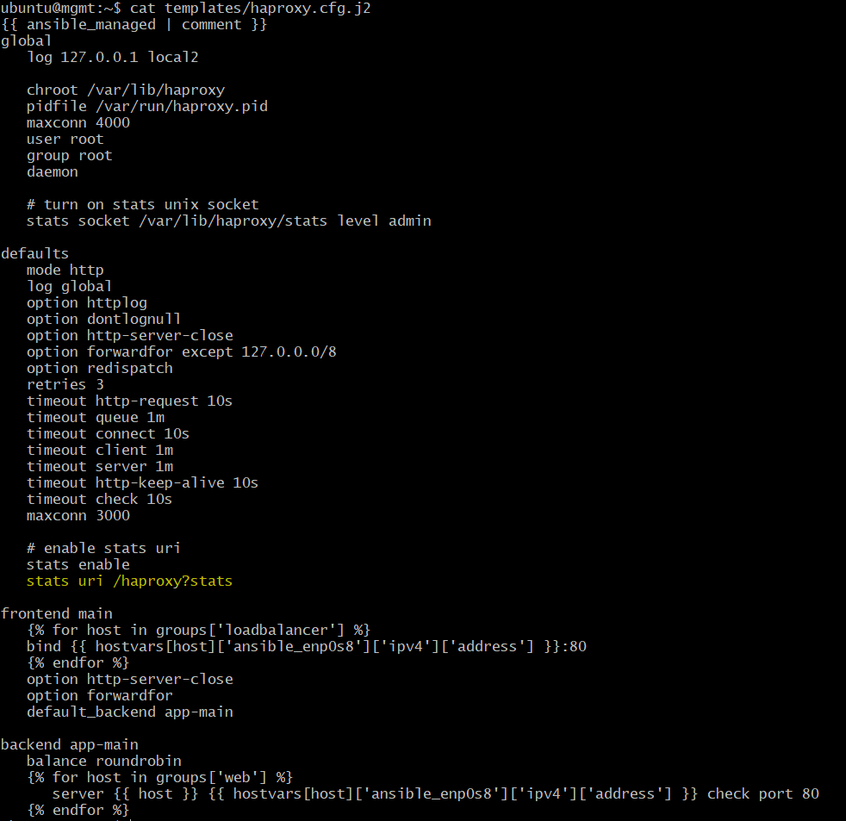
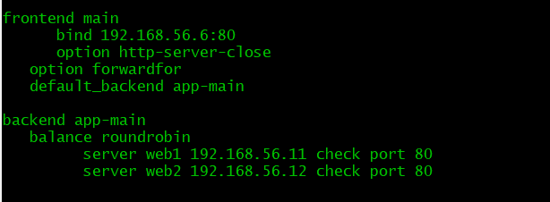
Templates – haproxy.cfg.j2
lb: /etc/haproxy/haproxy.cfg

Slide 39
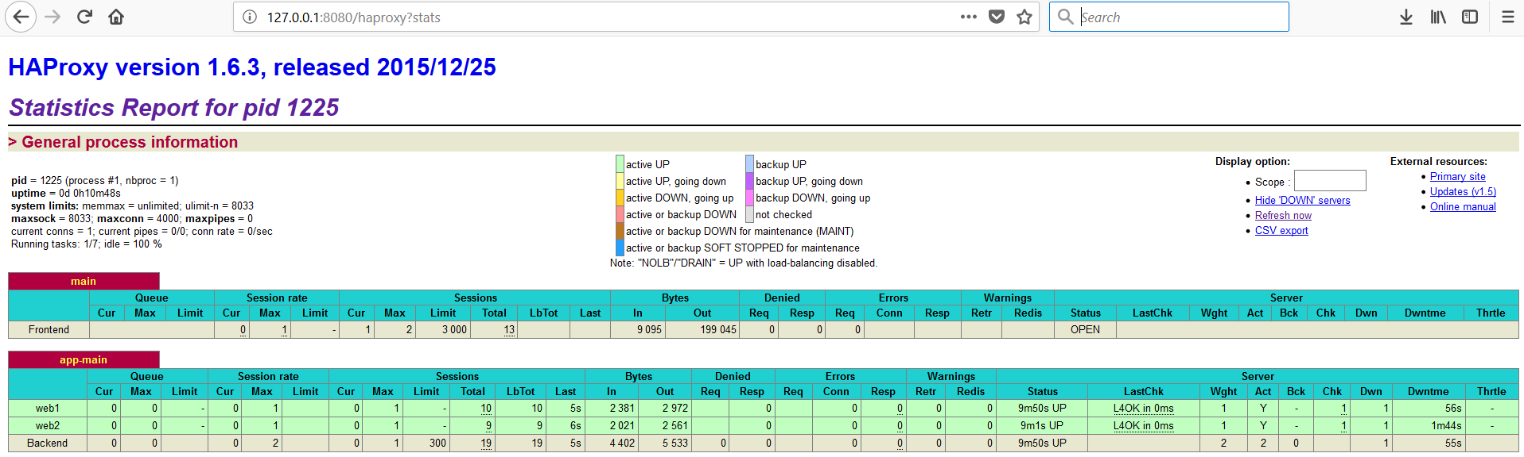
haproxy stats URI

Slide 40
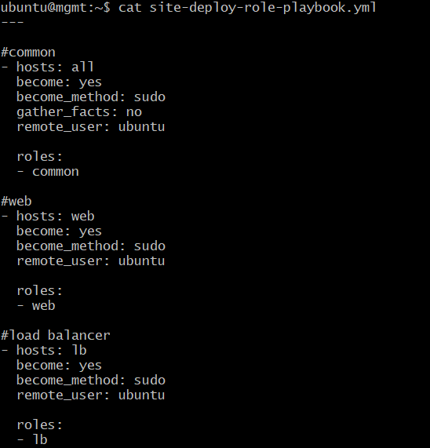
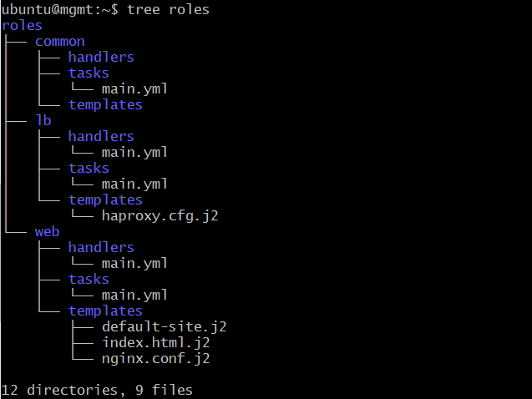
Ansible Roles - Modular

Slide 41
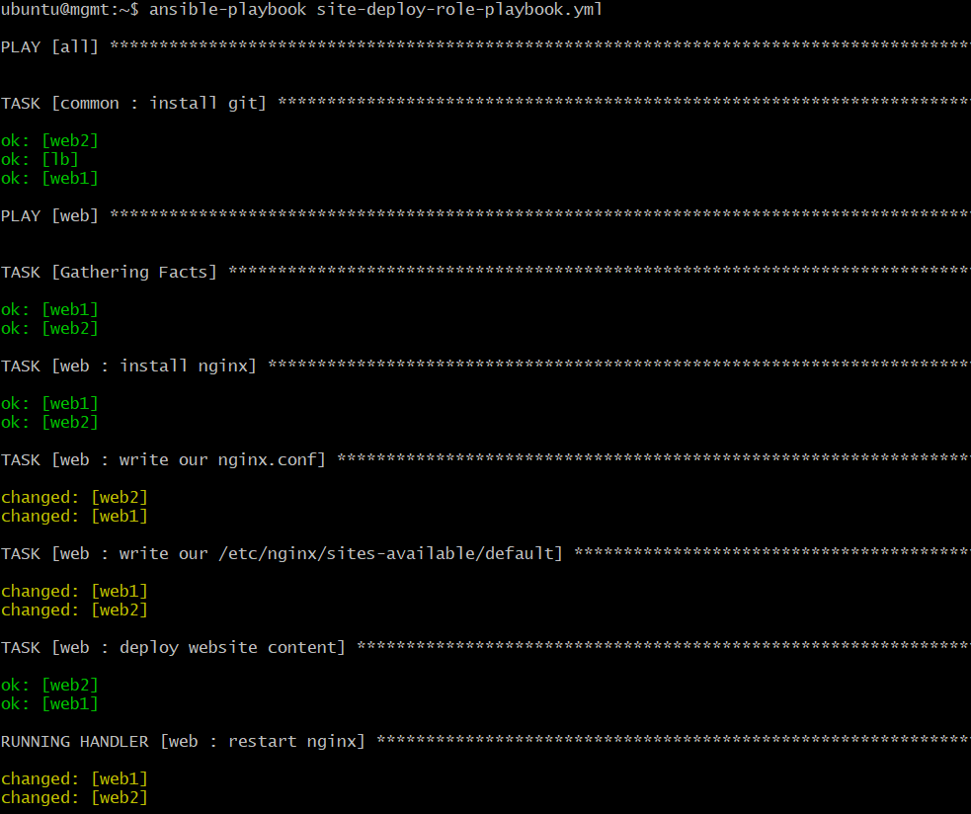
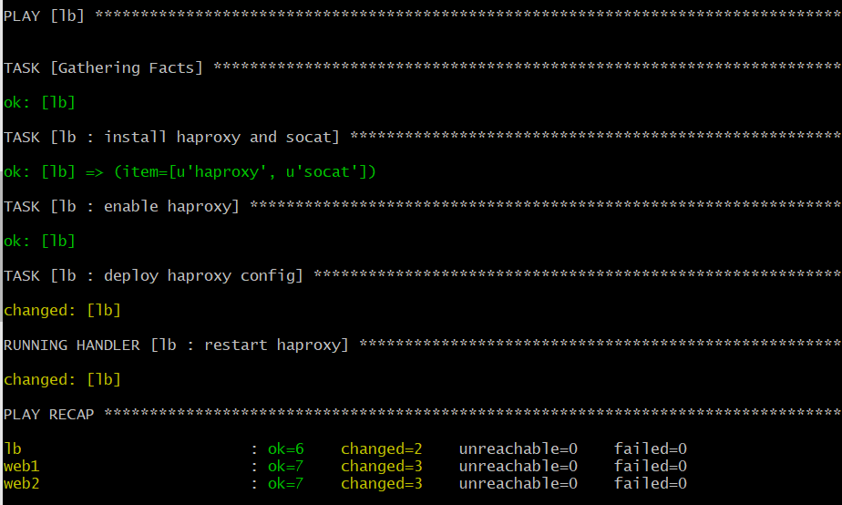
Ansible Roles - Modular

Slide 42
Zero downtime Deployments with Ansible
Rolling Applications Updates
Pre_Tasks:
Disable web node in haproxy
Tasks:
Install nginx package (package)
Write nginx.conf config file (file)
Clean existing website content
Deploy website content (from Github)
Start nginx (service)
Post_Tasks:
Enable web node in haproxy

Slide 43
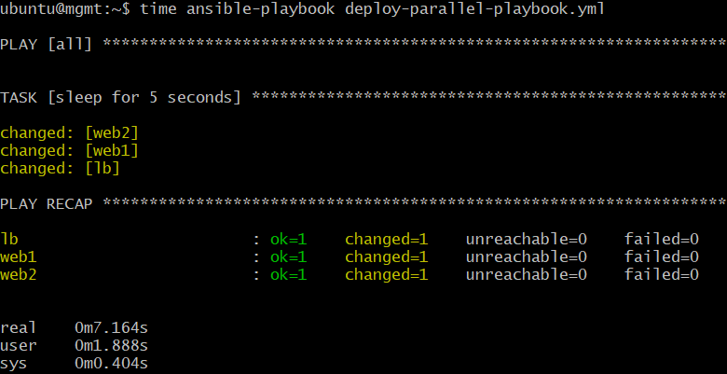
Parallel vs Serial Deployment
LB
SSH Trust
Ansible Mgmt Node
VM
WEB1
SSH Trust
SSH Trust
WEB2
ubuntu@mgmt:~$ cat ansible.cfg
[defaults]
inventory = /home/ubuntu/inventory.ini
#count of parallel processes to spawn when communicating with remote hosts
forks=15
ansible_managed = This file is managed by Ansible.%n
template: {file}
date: %Y-%m-%d %H:%M:%S
user: {uid}
host: {host}
Host Inventory
inventory.ini
Playbook
deploy-parallel-playbook.yml

Slide 44
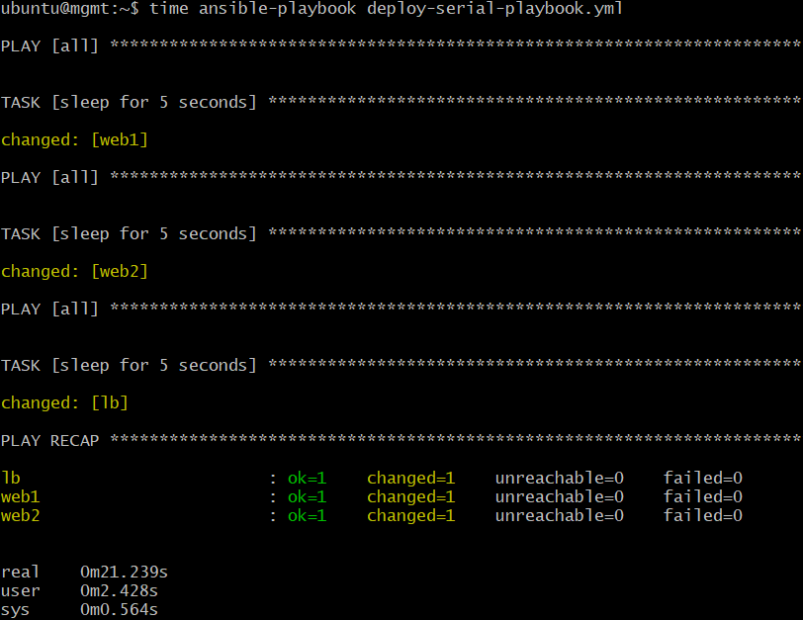
Parallel vs Serial Deployment
LB
SSH Trust
Ansible Mgmt Node
VM
WEB1
SSH Trust
ubuntu@mgmt:~$ cat deploy-serial-playbook.yml
---
#common
- hosts: all
become: yes
become_method: sudo
gather_facts: no
remote_user: ubuntu
#number of host per rolling updates
serial: 1
tasks:
- name: sleep for 5 seconds
shell: /bin/sleep 5
SSH Trust
WEB2
Host Inventory
inventory.ini
Playbook
deploy-serial-playbook.yml

Slide 45
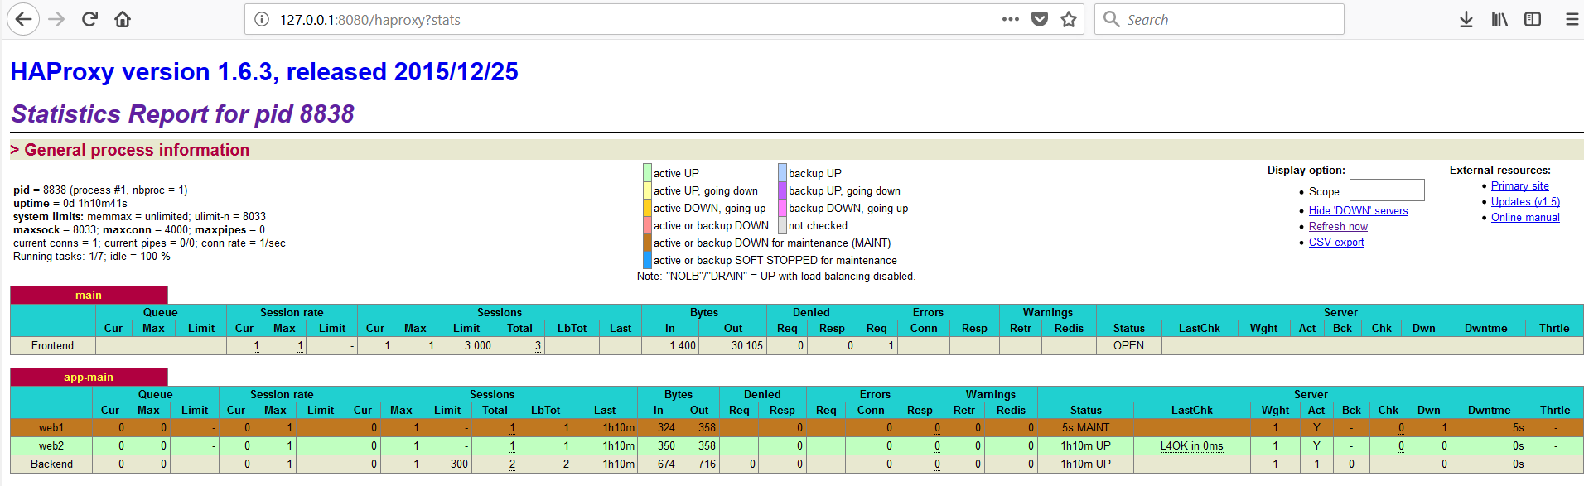
haproxy Maintenance Mode (disable/enable)
root@lb:~# echo "disable server app-main/web1" | socat stdio /var/lib/haproxy/stats

Slide 46
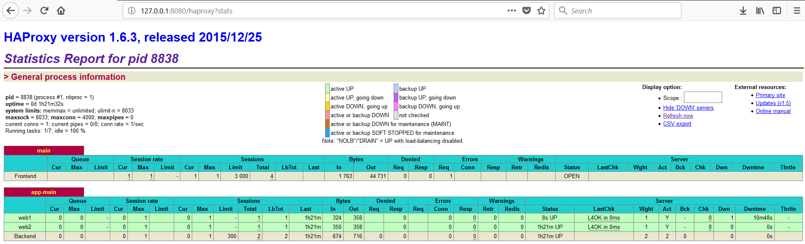
haproxy Maintenance Mode (disable/enable)
root@lb:~# echo “enable server app-main/web1" | socat stdio /var/lib/haproxy/stats

Slide 47
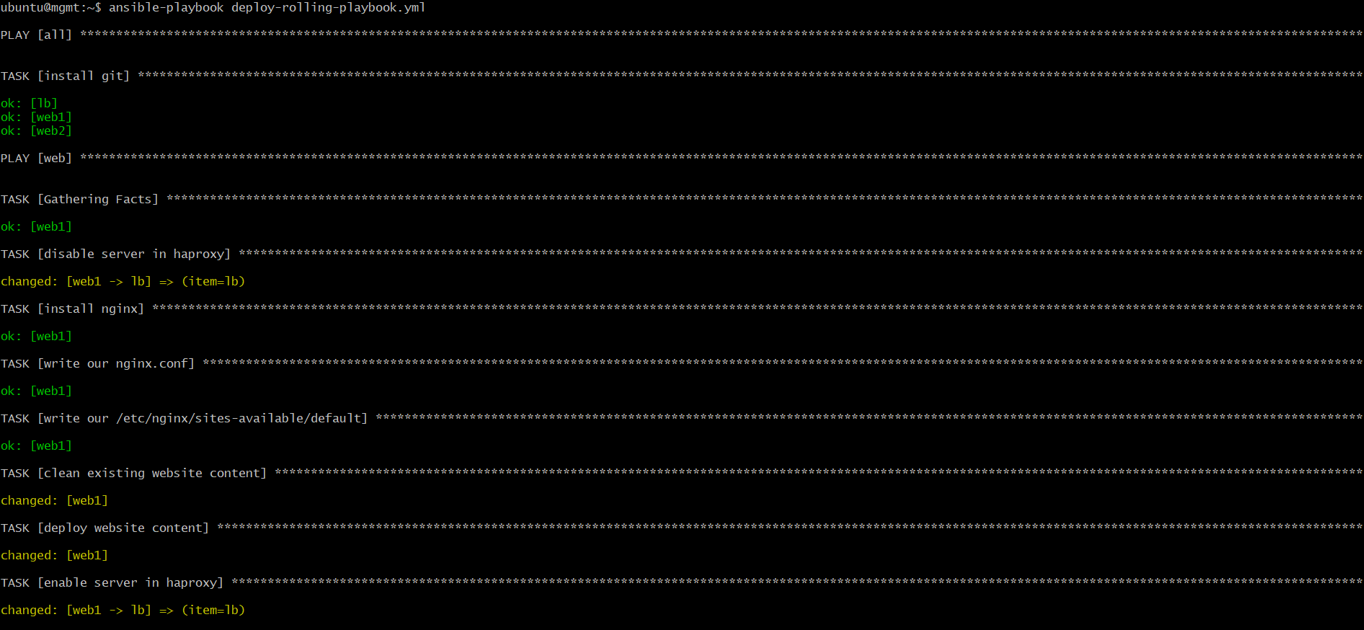
Zero downtime Deployments with Ansible

Slide 48
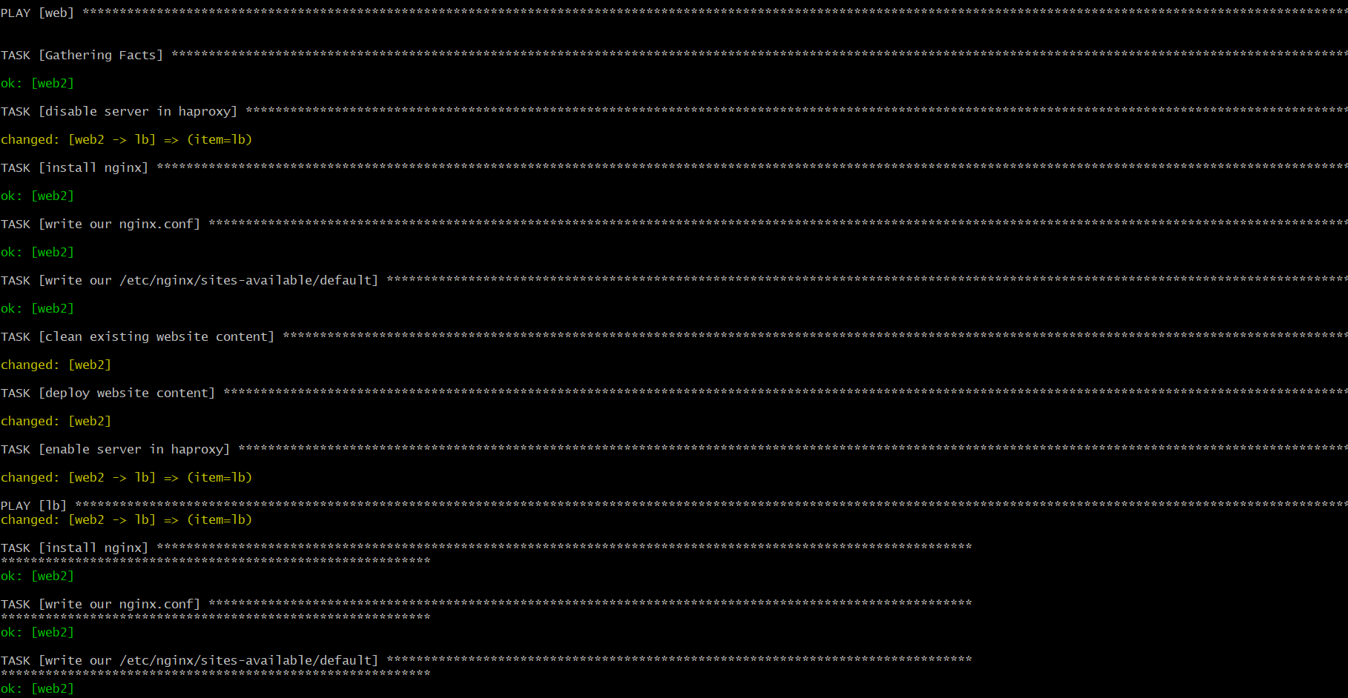
Zero downtime Deployments with Ansible

Slide 49
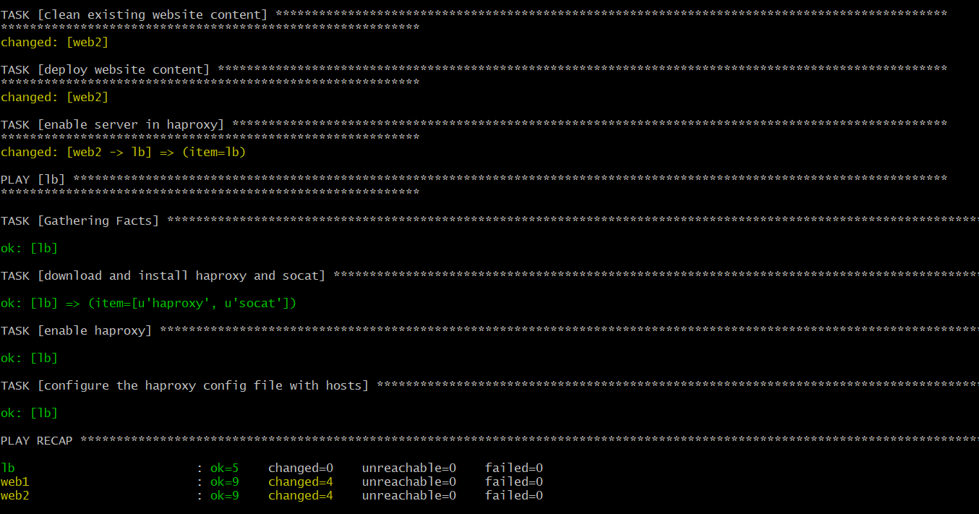
Zero downtime Deployments with Ansible

